Slide 1


扁平渐变插画风模板
The user can demonstrate on a projector or computer, or print the presentation and make it into a film to be used in a wider field
某小满dWWsign

Slide 2

第一部分
The user can demonstrate on a projector or computer, or print the presentation and make it into a film to be used in a wider field
第二部分
The user can demonstrate on a projector or computer, or print the presentation and make it into a film to be used in a wider field
目录
第三部分
The user can demonstrate on a projector or computer, or print the presentation and make it into a film to be used in a wider field
CONTENT
第四部分
The user can demonstrate on a projector or computer, or print the presentation and make it into a film to be used in a wider field

Slide 3

第一部分
PART ONE
输入您的文字描述输入您的文字描述输入您的文字描述输入您的文字描述输入您的
The user can demonstrate on a projector or computer.or presentation and make it film to be used in a wider field.

Slide 4

标题文字添加
The user can demonstrate on a projector or computer, or print the presentation and make it into a filmThe user can demonstrate on a projector or computer, or print the presentation and make it into a filmThe user can demonstrate on a projector or computer, or print the presentation and make it into a film
文字添加
文字添加
文字添加

Slide 5
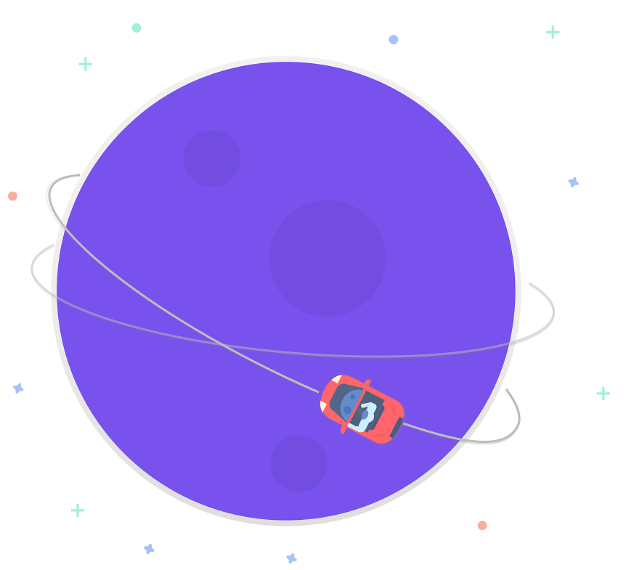
输入标题
print the presentation and make it into a film a wider field
标题文字添加
标题文字添加
The user can demonstrate on a projector or computer, or presentation and make it film to be used in a wider field
The user can demonstrate on a projector or computer, or presentation and make it film to be used in a wider field
标题文字添加
标题文字添加
The user can demonstrate on a projector or computer, or presentation and make it film to be used in a wider field
The user can demonstrate on a projector or computer, or presentation and make it film to be used in a wider field

Slide 6

输入标题
print the presentation and make it into a film a wider field
标题文字添加
标题文字添加
标题文字添加
标题文字添加
The user can demonstrate on a projector or computer, or presentation and make it film to be used in a wider field
The user can demonstrate on a projector or computer, or presentation and make it film to be used in a wider field
The user can demonstrate on a projector or computer, or presentation and make it film to be used in a wider field
The user can demonstrate on a projector or computer, or presentation and make it film to be used in a wider field

Slide 7

第二部分
PART TWO
输入您的文字描述输入您的文字描述输入您的文字描述输入您的文字描述输入您的
The user can demonstrate on a projector or computer.or presentation and make it film to be used in a wider field.

Slide 8

点击添加标题
您的内容打在这里，或者通过复制您的文本后，在此框中选择粘贴，并选择只保留文字
点击添加标题
您的内容打在这里，或者通过复制您的文本后，在此框中选择粘贴，并选择只保留文字
点击添加标题
您的内容打在这里，或者通过复制您的文本后，在此框中选择粘贴，并选择只保留文字
点击添加标题
您的内容打在这里，或者通过复制您的文本后，在此框中选择粘贴，并选择只保留文字

Slide 9

输入标题
print the presentation and make it into a film a wider field
标题文字添加
标题文字添加
print the presentation and make it film to be used in a wider field
print the presentation and make it film to be used in a wider field
标题文字添加
标题文字添加
print the presentation and make it film to be used in a wider field
print the presentation and make it film to be used in a wider field

Slide 10

52
%
标题文字添加
print the presentation and make it film to be used in a wider field
38
%
标题文字添加
print the presentation and make it film to be used in a wider field

Slide 11



输入标题
print the presentation and make it into a film a wider field
标题文字添加
标题文字添加
标题文字添加
The user can demonstrate on a projector or computer, or presentation and make it film to be used in a wider field
The user can demonstrate on a projector or computer, or presentation and make it film to be used in a wider field
The user can demonstrate on a projector or computer, or presentation and make it film to be used in a wider field

Slide 12

第三部分
PART THREE
输入您的文字描述输入您的文字描述输入您的文字描述输入您的文字描述输入您的
The user can demonstrate on a projector or computer.or presentation and make it film to be used in a wider field.

Slide 13
输入标题
print the presentation and make it into a film a wider field
点击添加标题
点击添加标题
您的内容打在这里，或者通过复制您的文本后，在此框中选择粘贴，并选择只保留文字
您的内容打在这里，或者通过复制您的文本后，在此框中选择粘贴，并选择只保留文字
点击添加标题
点击添加标题
您的内容打在这里，或者通过复制您的文本后，在此框中选择粘贴，并选择只保留文字
您的内容打在这里，或者通过复制您的文本后，在此框中选择粘贴，并选择只保留文字
点击添加标题
点击添加标题
您的内容打在这里，或者通过复制您的文本后，在此框中选择粘贴，并选择只保留文字
您的内容打在这里，或者通过复制您的文本后，在此框中选择粘贴，并选择只保留文字

Slide 14
输入标题
print the presentation and make it into a film a wider field
输入您的文字描述输入您的文字描述输入您的文字描述输入您的文字描述输入您的
文字描述输入您的文字描述输入您的文字描述输入您的
输入您的文字描述输入您的文字描述输入您的文字描述输入您的文字描述输入您的
文字描述输入您的文字描述输入您的文字描述输入您的
输入您的文字描述输入您的文字描述输入您的文字描述输入您的文字描述输入您的
文字描述输入您的文字描述输入您的文字描述输入您的
输入您的文字描述输入您的文字描述输入您的文字描述输入您的文字描述输入您的
文字描述输入您的文字描述输入您的文字描述输入您的
月小满design
月小满design
月小满design
月小满design

Slide 15

标题文字添加
您的内容打在这里，或者通过复制您的文本后，在此框中选择粘贴，并选择只保留文字
The user can demonstrate on a projector or computer, or print the presentation and make it into a filmThe user can demonstrate on a projector or computer, or print the presentation and make it into a filmThe user can demonstrate on a projector or computer, or print the presentation and make it into a film
月小满design

Slide 16

输入标题
print the presentation and make it into a film a wider field
标题文字添加
标题文字添加
您的内容打在这里，或者通过复制您的文本后，在此框中选择粘贴，并选择只保留文字
您的内容打在这里，或者通过复制您的文本后，在此框中选择粘贴，并选择只保留文字
The user can demonstrate on a projector or computer, or presentation and make it film to be used in a wider field
The user can demonstrate on a projector or computer, or presentation and make it film to be used in a wider field

Slide 17

第四部分
PART FOUR
输入您的文字描述输入您的文字描述输入您的文字描述输入您的文字描述输入您的
The user can demonstrate on a projector or computer.or presentation and make it film to be used in a wider field.

Slide 18

输入标题
print the presentation and make it into a film a wider field

Slide 19
输入标题
print the presentation and make it into a film a wider field
40%
30%
85%
65%
35%
标题文字
标题文字
标题文字
标题文字
标题文字

Slide 20
谢谢欣赏
The user can demonstrate on a projector or computer, or print the presentation and make it into a film to be used in a wider field
某小满dWWsign

